Slide 1
Christopher B. Barrett Cornell University Calvin College Summer Seminar on the Economics of Global Poverty August 2013
Publishing and Collaborations:
Some Tips for Young Economists

Slide 2
Introduction
Why publish? (why do you want to do this?)
Professional returns
Salary, promotion/tenure, stature, etc.
Learn
The writing process is part of how we learn.
Education
Share new discoveries with others who might be interested. Contribute to public good (pay back/pay forward).
Personal returns
Satisfying, ‘make Mom/Dad proud’, etc.
It takes much more than #1 to publish successfully.

Slide 3
Some keys to publishing
Good Ideas
The core of good research is a good idea. Think creatively!
Strive to address important topics. You will have to work hard at any paper. So devote that scarce time to research that may make a real difference (not just add a line to your cv).
Especially for empirical work, choose topics where the result is interesting no matter what answer you get. Minimizes the risk of both zero return and torturing the data.

Slide 4
Some keys to publishing
Good Ideas 2
The best research does one of the following:
Reveals (perhaps even explains?) a new and interesting fact
Provides an empirically accurate, theoretically coherent explanation of a previously unexplained phenomenon
Resolves a puzzle
Explodes a myth
Offers new info on a topic of impending public interest
Presents a new method or theory
Ask yourself whether your research idea fits one of those categories???
(Pure descriptive work or modeling for its own sake rarely do.)

Slide 5
Some keys to publishing
Technical Skills
Economics occupies a privileged place among the social sciences because we have a bigger, better, technical toolkit. Use it!
There is a life cycle to technical skills. Seize every opportunity in the early post-Ph.D. period to ‘tech up’. Build complementary skills that you can integrate to form useful, even novel composites.
Play to your strengths . Don’t try to write the papers that rely on skills you don’t really have. Know thyself!
When you have a great idea but don’t have the necessary skill(s), seek out a suitable collaborator.

Slide 6
Some keys to publishing
Disciplined Use of Time
Time (not money) is our scarcest resource
Schedule writing time – always takes far longer than desired. And requires clear thinking; do it whenever you’re sharpest.
Rewrite repeatedly and ruthlessly (‘shitty first drafts’)
Know your desired audience and write for them, and send to outlets appropriate to them.
Prioritize R&Rs – once you’ve found a receptive editor and reviewers, finish off the paper and get it published! Don’t wait for the editor to change or someone else to scoop your work.

Slide 7
Some keys to publishing
Eagerness to Seek Feedback and Thick Skin
Seek feedback to ensure you’ve got everything right. Critical feedback is invaluable!
Send a polished (not first, raw) draft out for comments – but don’t expect much (and don’t pester people!)
Seize every opportunity to present your work … better to appear inexperienced than be completely unknown!
Critically consider criticism. Few reviewers/editors will think as carefully about your work as you do. Criticisms aren’t always accurate. Substantively revise only in response to the sensible substantive critiques; make editorial revisions to address the others, as they signal unclear writing.

Slide 8
Some keys to publishing
Develop A Publication Strategy
Have a ‘submission tree’ in mind for each paper
Don’t undersell your work! Unless very pressed for time (e.g., immediately pre-tenure), shoot for a journal better than where the paper is most likely to appear. You get a high upside and better average reviewer quality.
Anticipate rejection. In my experience, <2% of 1st submissions get a conditional acceptance straight away; <1/3 get R&R on 1st submission.
Submit everything until either you conclude it’s wrong or it publishes … many highly cited papers were rejected repeatedly, and many land in ‘lower-ranked’ journals but subsequently have considerable impact.

Slide 9
Introduction 2
Why collaborate? (why do you want to do this?)
Professional returns
Access to grants, networking, stature, etc.
Learn
We learn from working with others.
Education
Share new discoveries with others who might be interested. Contribute to public good (pay back/pay forward).
Personal returns
Make/maintain friendships, help/be helped by others
Successful collaboration requires much more than #1!

Slide 10
Introduction 2´
Why not collaborate?
Prove your independent research capacity
Sole-authored publications confirm an individual’s ability to due high quality work.
But don’t need mostly these
… repeated collaborations with respected scholars is a strong positive signal about you.
Not many other good reasons not to collaborate!

Slide 11
Keys to collaborations
Work With People You Like, Respect and Trust
Generate good ideas together by talking about the world. Who do you like to talk with about important issues? Do you routinely leave a lunch or coffee with someone intellectually stimulated?
You will inevitably divide up tasks. Whose skills do you respect? To whose judgment will you entrust your reputation?
Whose work style/pace suits your own temperament? (Disciplined types commonly find it difficult to work with even brilliant procrastinators.)
Work with those people!

Slide 12
Keys to collaborations
Play to Comparative Advantage
Seek out others who have skills that match your weaknesses. Each partner should understand all of the project. But seek out gains from trade of talents.
Don’t keep working with your adviser just because you like him/her or s/he is prominent. Should grow out of master-apprentice style work after dissertation papers are all published. Thereafter, collaborate only as equal partners.

Slide 13
Keys to collaborations
Invest in clear communication with collaborators
Be clear about mutual expectations:
What are the objectives of this work? Target outlet(s)?
What division of labor?
What software will you use?
Ordering of names on manuscripts?
Who starts drafting? Makes final submission decision?
Let collaborators know about related projects that intersect with your collaboration. Avoids misunderstanding or worse.

Slide 14
Keys to collaborations
Sacrifice and compromise!
Inevitably, there will be differences of opinion.
Don’t escalate simple disagreements into big disputes. Keep in mind why you’re working together – to learn from and educate each other, to enjoy each other’s company, to match complementary skills.
Clarity about mutual expectations helps. But no one can plan for all contingencies.
If you value the professional relationship and/or personal friendship, be prepared to set aside your ego.

Slide 15
Interdisciplinary collaboration
Pros
Steep learning curve when there is modest overlap. One learns a lot.
Intellectual arbitrage opportunities abound when one makes contact with multiple domains
Reach much broader audience … impact a wider range of researchers and practitioners, and attract more citations .
More interesting real world questions cut across disciplinary boundaries than fall purely within them.
Lots of extra grant funding available

Slide 16
Interdisciplinary collaboration
Cons
Beware the least-common-denominator sort of outputs. Those are easy but largely a waste of time. Rather, work to combine the best of each into a richer synthesis.
Often very time intensive. Need to overcome differences of disciplinary jargon, evidentiary standards, etc. Is the extra time worth it?
Often dismissed by more close-minded disciplinary colleagues
All the earlier key points about collaborations become even more important in interdisciplinary work.

Slide 17
Conclusion
For any scholar, publication and its byproducts – impacts on other scholars (e.g., citations), policy, professional reputation, etc. – are the key currency.
Collaborations are both instrumentally valuable (in advancing one’s research agenda) and intrinsically valuable (e.g., build enduring friendships, enjoy lifelong learning and service opportunities).
Both can and do happen serendipitously. But success in each is more likely when you approach these objectives thoughtfully and strategically.

Slide 18
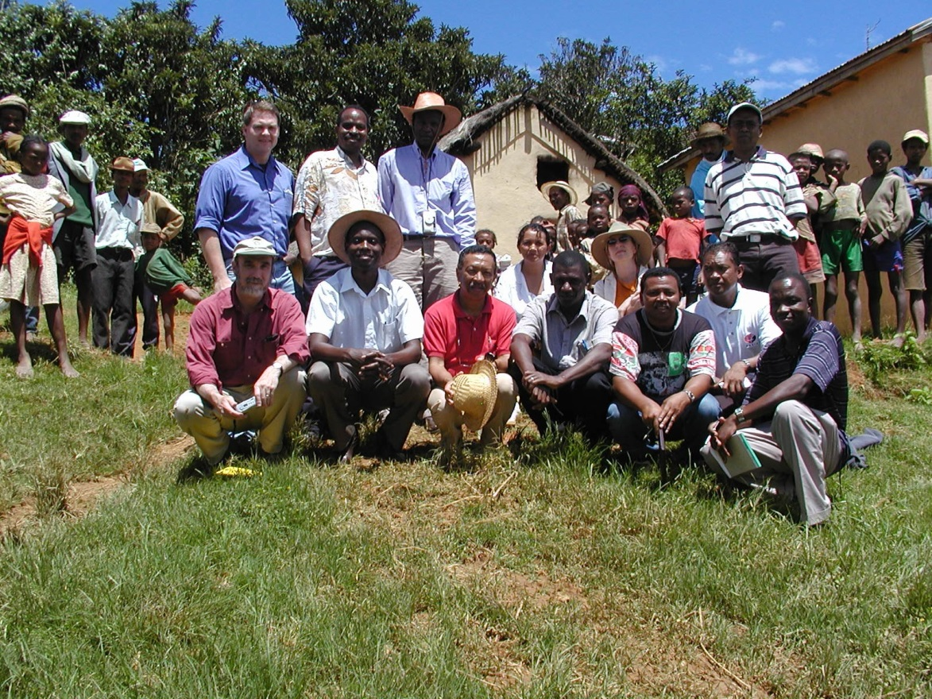
Thank you
Good luck!
and thank you for your time and attention

